Slide 1



Talent Intelligence And
Management Report 2019-2020

Slide 3
The Talent Crisis Is Getting Worse.
AI Can Solve It.
For the 2019-2020 survey, we spoke to CEOs and CHROs of enterprises in the US and several European countries as well as samples of their full-time employees. We wanted to learn what talent challenges they face in common and how views differ between management and employees across countries.
The survey contains key findings from more than 1,500 interviews conducted during the summer of 2019.
We learned that the talent crisis has not abated, and if anything, has grown more challenging since last year. While there are variations among the countries, the simple reality is that actively hiring employers and talented employees cannot easily find each other, leading to poor experiences and frustrations on both sides.
When asked about important topics such as succession planning, internal mobility, and bias prevention, only some organizations have taken action, though most see tremendous value in addressing such topics. Employees agree with CEOs and CHROs that their companies should improve their practices around bias prevention with candidate masking, internal mobility with career pathing, and other new policies and solutions. There are some variations by country, with the English-speaking countries (US and UK) tending to move together.
CEOs and CHROs say their HR practices are lagging on technology adoption. Fortunately, artificial intelligence (AI) can help HR and talent teams address challenges such as filling open roles, succession planning, short employee tenures, and lack of diversity at scale. Enterprises are embracing advanced AI technologies to solve talent challenges, and their employees are more accepting of these technologies than not. The talent crisis is real, and AI has the potential to solve it.
64%
US HR teams are not capitalizing on all available new technology
65%
German companies can’t find enough suitable candidates
73%
French companies would benefit from more efficient succession planning

Slide 4





Companies Are Struggling to Build Qualified Talent Pipeline
Large majorities of CEOs and CHROs say they can’t discover qualified candidates despite being overwhelmed with resumes. Receiving a lot of applications is a sign of a strong employer brand, but if the company can’t capitalize on this interest, the brand value is wasted. Moreover, the brand will inevitably grow weaker if thousands of disappointed applicants get no response from the company. In the Talent Intelligence and Management Report 2018, 73% of CEOs and CHROs said they couldn’t find enough qualified candidates, a result virtually unchanged this year. Better matching technology would help companies to solve this challenge.
CEO & CHRO Survey Findings
We have specific roles that are hard to fill
We can’t find enough suitable candidates
We don’t have enough staff to wade through resumes
to find suitable candidates
We often need to find unconventional candidates to fill roles

Slide 5
Employees Can’t Discover Careers That Match Their Skills, Potential And Goals
Large Large majorities of employees struggle to discover careers that fit their experience, and locating a match is getting harder. These difficulties are especially pronounced in English-speaking countries. This result mirrors the responses from CEOs and CHROs, who say they can’t find employees who meet their requirements. Employees would benefit from employer investment in matching technology that goes beyond keywords.
Employee Survey Findings
My specialized experience makes it tough to find a role
Employers don’t see my true potential
It’s harder to find suitable roles in the last few years
I spend too much time searching for a job

Slide 6
Recruiting Challenges Hurt Business Productivity
The number-one hiring concern of CEOs and CHROs everywhere is discovering qualified candidates. When companies can’t discover the right candidates, they will accept poor-fit hires leading to lower productivity. When employees switch jobs frequently, they fail to reach high levels of productivity before leaving. And extended hiring cycles that leave roles unfilled also hurt production. Broken processes and inadequate systems are leading to a significant talent crisis.
CEO & CHRO Survey Findings: Top 4 reasons why it is tough to fill particular roles
#1 It is difficult to find the right candidates to interview
#2 Recruiters never seem to understand our specific needs
#3 We find it difficult to understand the potential that candidates have
#4 Our job specs and targeting are not sufficiently personalized

Slide 7
The Candidate Experience Defines Employer Brand
Many employees say they will not work for companies that communicate poorly. Examples of poor communication include non-response, slow response, impersonal emails, and failure to remove filled positions from job listings. These aspects of the candidate experience directly impact the employer brand. Companies that fail to deliver a good candidate experience will quickly fail to attract candidates. Personalized, rapid, and relevant responses to candidates deliver a positive candidate experience.
Employee Survey Findings
…I would not work for the company
…I might work for the company
…I would still work for the company

Slide 8
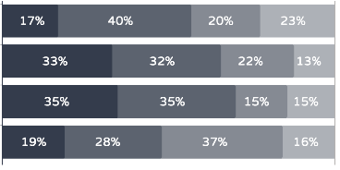
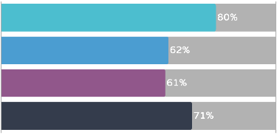
80% Of Companies Have Inadequate Succession Planning
70%+ Believe Succession Planning Will Benefit The Organization
Succession planning in most companies is limited to the C-suite, but in today’s world, succession plans are needed for everyone in order to create internal mobility, improve retention, and show all employees that there are career paths to the top of the organization. In order to have succession plans for everyone, companies need an automated way to manage succession planning.
CEO & CHRO Survey Findings
Job hopping makes HR’s job more difficult
Job hopping has increased over the last 5 years
United States
France
Germany
United Kingdom

Slide 9
Internal Mobility Is A Strategic Focus For More Than Two-Thirds Of Executives
Most CEOs and CHROs say internal mobility is a key focus, but the employee response on career-pathing (see Page 11) suggests that current efforts are not adequate to motivate and retain employees. In the Talent Intelligence and Management Report 2018, 83% of surveyed employees wanted a new job but just 53% were willing to change companies, revealing the critical importance of internal mobility to solving the talent crisis. Despite executive intent, internal mobility is missing the mark for employees.
CEO & CHRO Survey Findings
Internal mobility is a key focus for us to ensure our company is motivating, developing, and retaining top talent

Slide 10
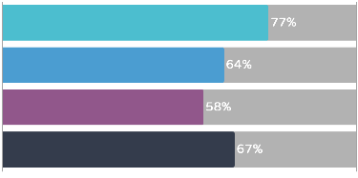
Job Hopping Continues To Increase
Frequent switching of employers, or “job hopping,” is on the rise. Employees are switching jobs often because they can’t find motivating career paths within their companies and their companies aren’t turning their focus on internal mobility into effective and scalable solutions. Unfortunately, internal mobility has not received enough investment and attention, worsening the talent crisis.
CEO & CHRO Survey Findings
Job hopping makes HR’s job more difficult
Job hopping has increased over the last 5 years

Slide 11
Career Paths Motivate More Than 60% Of Employees
Most employees say that they would be motivated by better-defined career paths, yet most also say their companies do not provide clear career paths for them. Succession planning and other career development efforts are powerful strategies to motivate and retain employees. Companies need insight into the skills and potential of each employee so that they can offer personalized career paths at scale.
Employee Survey Findings
I would be more motivated if I had a clearer career path

Slide 12






Employee Experience Is Becoming Top-Of-Mind For Executives
CEOs and CHROs want their employees to have a high opinion of their company. CEOs and CHROs are doing well in listening to their employees. Employees are looking past the usual perks (free lunches, etc.), expecting more meaningful rewards such as career-pathing, mentorship, and alignment with company mission.
CEO & CHRO Survey Findings
Our employees actively recommend us as a great employer
Our employees know their opinions count
Our employees feel fairly rewarded
Employee Survey Findings
I actively recommend my
organization as a great employer
I know my opinions count
I am fairly rewarded

Slide 13
43% of US Workforce Continues Face Discrimination
More than one-third of employees report negative effects of bias, especially in the US. This result highlights the need for stronger policies, procedures, and technologies to reduce the impact of bias.
Employee Survey Findings
I have faced job discrimination based on my age, gender, race, parental status, marital status, or disability

Slide 14
The US Is Leading In Bias Prevention With Candidate Masking
Hiding a candidate’s personal details to prevent bias, a proven-effective practice known as “candidate masking,” is gaining traction in the US. There is an opportunity for companies everywhere to embrace this effective and scalable measure to reduce the impact of bias.
CEO & CHRO Survey Findings
Candidate masking makes the recruitment process better

Slide 15
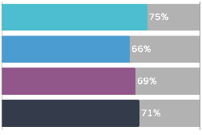
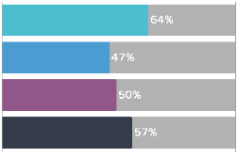
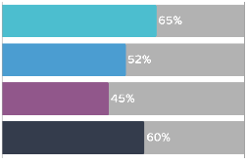
HR Teams Are Getting More Tech-Savvy
CEOs and CHROs say that HR is learning new technology skills, yet these executives also say their teams still need more technology, especially in the US. Learning these skills and adopting new technologies are critical for overcoming the challenges in recruitment, retention, diversity, and candidate experience that both the CEOs and CHROs and their employees describe in this survey. New technology is helping HR teams to become more effective, competitive, and productive.
CEO & CHRO Survey Findings
Our HR team has learned many new tech skills in the last few years
Our HR team is not capitalizing on all available new technology
Our HR team is probably behind the curve on technology

Slide 16
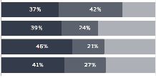
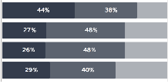
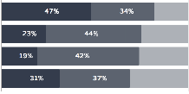
High Interest In AI Is Driving Adoption
To address the talent crisis, CEOs and CHROs say their companies are turning to AI. Most companies have not started using AI yet for critical tasks, but most are planning to do so in the coming few years. The US is far ahead on use of AI, and has doubled usage of AI for HR and talent programs in the last year. In the Talent Intelligence and Management Report 2018, just 22% of US CEOs and CHROs reported using AI for talent programs, compared to 47% using AI for recruitment this year. AI is delivering benefits that solve the talent crisis.
CEO & CHRO Survey Findings
United States
France
Germany
United Kingdom
United States
France
Germany
United Kingdom
United States
France
Germany
United Kingdom
Use are using AI for recruitment
We are interested in using AI for recruitment in the future
We are using AI for repetitive
HR tasks
We are interested in using AI for repetitive HR tasks in the future
We are using AI for employee retention
We are interested in using AI for employee retention in the future

Slide 17
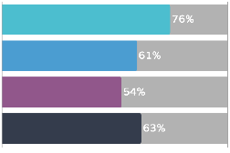
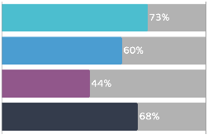
US Is Leading In AI Adoption And The Ensuing Benefits
Seeing its value, most CEOs and CHROs plan to increase the usage of AI in the next 3 years, with the US leading in AI interest. These results build on the finding in the Talent Intelligence and Management Report 2018, in which 68% of US CEOs and CHROs said that AI makes HR programs more likely to be successful. The enterprises that adopt AI fastest will be the first to overcome the talent crisis.
CEO & CHRO Survey Findings
New technologies have had
positive impacts overall
We plan to use more AI
within 3 years
Employees are less concerned about AI now that they see its benefits

Slide 18
Participant Profiles
Methodology: For this report, we worked with Harris Interactive to survey business leaders and employees. We surveyed people during June and July, 2019 using online interviews.
CEOs and CHROs
For the executive survey, we received 1,350 complete interview responses, evenly split between CEOs and CHROs. At least 200 responses were received for each country surveyed: the United States, France, Germany, and the United Kingdom. All participants were CEOs or CHROs of companies with 1,000 or more employees.
Employees
For the employee survey, we received 279 complete interview responses. In order to participate in the survey, all respondents were required to be full-time employees of a company with 1,000 or more employees and to report having looked for a job within the prior 3 years. At least 50 responses were received for each country surveyed.

Slide 20

Eightfold delivers the Talent Intelligence Platform, the most effective way for companies to identify promising candidates, reach diversity hiring goals, retain top performers, and engage talent. Eightfold’s patented artificial intelligence–based platform empowers enterprises to turn talent management into a competitive advantage. Built by top engineers out of Facebook, Google and other leading technology companies, Eightfold is based in Mountain View, California. Recently, Eightfold published its first book, What’s Next for You: The Eightfold Path to Transforming the Way We Hire and Manage Talent.
For more information, visit www.eightfold.ai.

